Slide 1
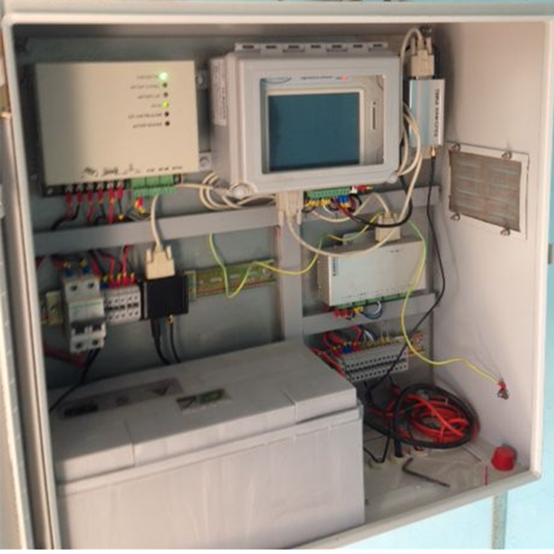
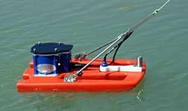
Surface-Water Instrumentation
Module 15
Some slides taken from HP-2 training module by Mark Heggli
Revised by: Steve Lipscomb

Slide 2
Examples that refer to products are intended for illustrative purposes only, and do not imply an endorsement or recommendation of any particular product

Slide 3
Instrumentation Solutions For:
Surface Water Level
Discharge
Ground Water
Data Loggers

Slide 4
Surface Water Level:
Two categories of water level sensors
Contact and Non-Contact Solutions
Contact
Sensor or other components that are in contact with the water being measured
Susceptible to debris, siltation, vandalism
Includes:
Shaft Encoder/ Stilling Well
Bubbler
Submersible Pressure Transducer
Non- Contact
Sensor components are not in contact with the water being measured
Includes:
Ultrasonic Sensor
Radar

Slide 5
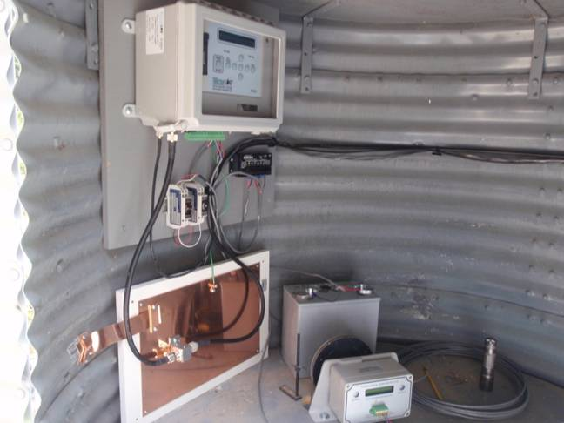
Stilling Well/Shaft Encoder
Concept
Water comes into the stilling well through inlet pipes from the water source
As water level increases and decreases, a float moves up and down with the water level
A tape attached to the float turns a wheel which is connected to the shaft on the encoder. As the wheel turns so does the shaft.
The shaft encoder will convert the shaft rotations to an electronic signal, which will be measured by a data logger
The components of this type of gauge include:
A stilling well
Inlet pipes from the water
Float and weight
Tape
Wheel
Shaft encoder
Float
Water Inlet

Slide 6
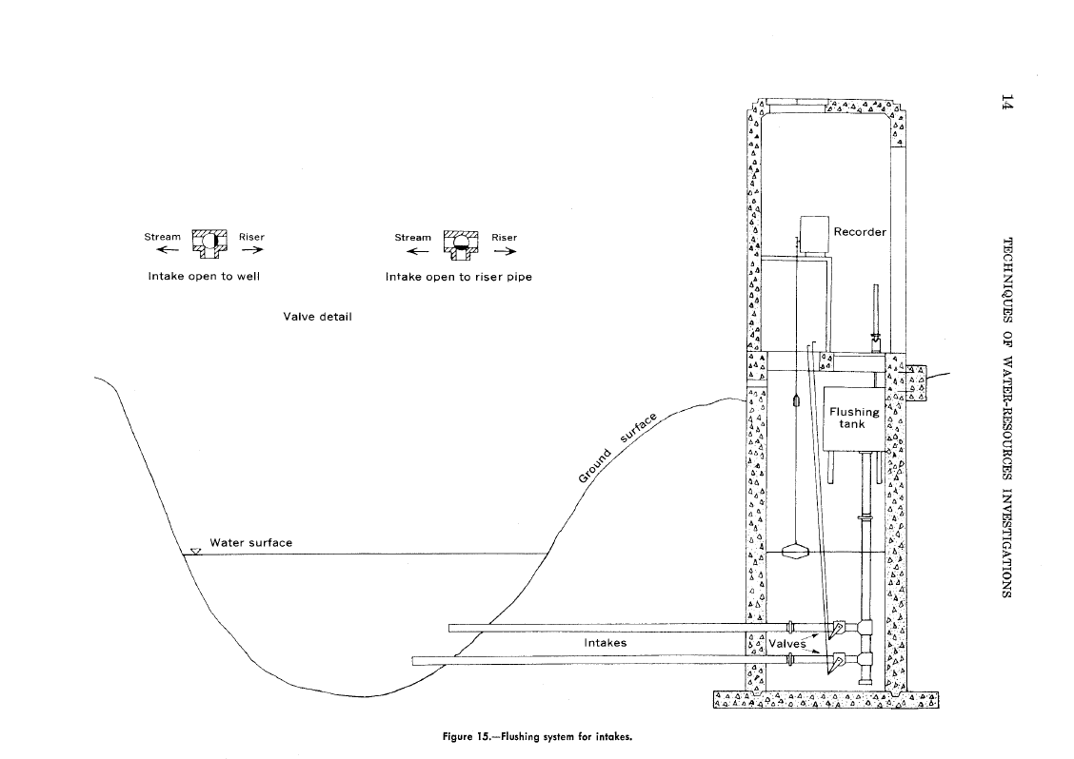
Stilling Well Intake Flushing System
Stilling Well with Intake Cleanout
Stilling wells can be used
with other sensors.

Slide 7
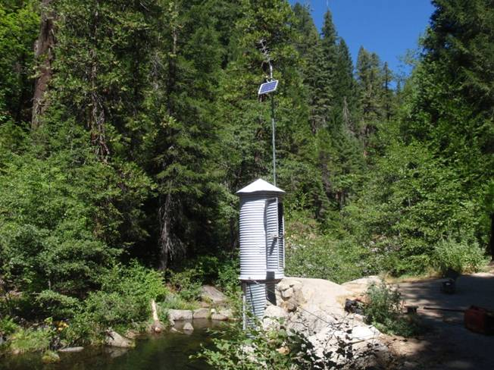
Shaft Encoder Installation and Ideal Location
Installation
The civil works for this type of station is among the most expensive, while the sensor and associated equipment is among the least expensive sensor solutions
Ideal Location
Stable river beds where the channel does not change or migrate away from intakes
Site with minimal sedimentation

Slide 8
Shaft Encoder Advantages/Disadvantages
Advantages
Low cost of equipment
No electronic sensor calibration required, but only checked and reset to an outside staff gauge
Disadvantages
Expensive civil works
Requires occasional flushing to remove sediments that may have collected at the bottom of the stilling well. If left unchecked, the sediments could eventually block the inlet/outlet pipes

Slide 9
Bubbler
Concept
The bubbler is a stage measurement device that has a non-submersible sensor
Also known as a gas-purge system the system allows a small quantity of air or inert gas to bleed through a pipe or tubing to an orifice in the stream
The pressure of the gas that displaces the liquid in the orifice is then measured by a pressure transducer located in the gauge house.
Non- Submersible Pressure Transducer

Slide 10
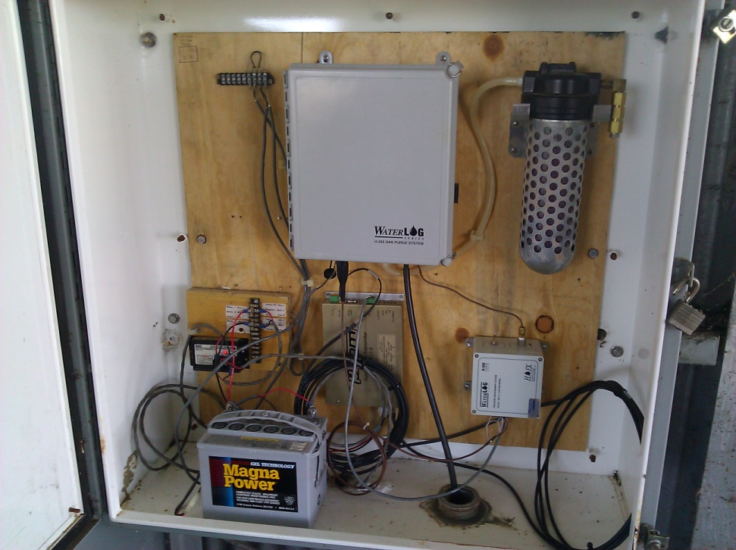
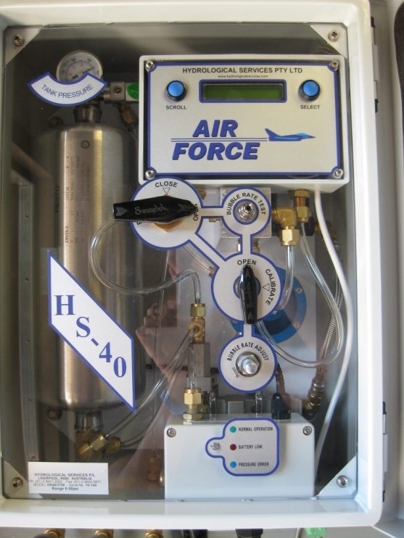
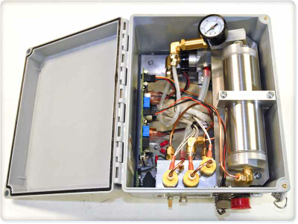
Bubbler Components
Bubbler
Compressor
Orifice Line
Pressure Transducer
Tank
Desiccant
Desiccant
Air Drying System

Slide 11
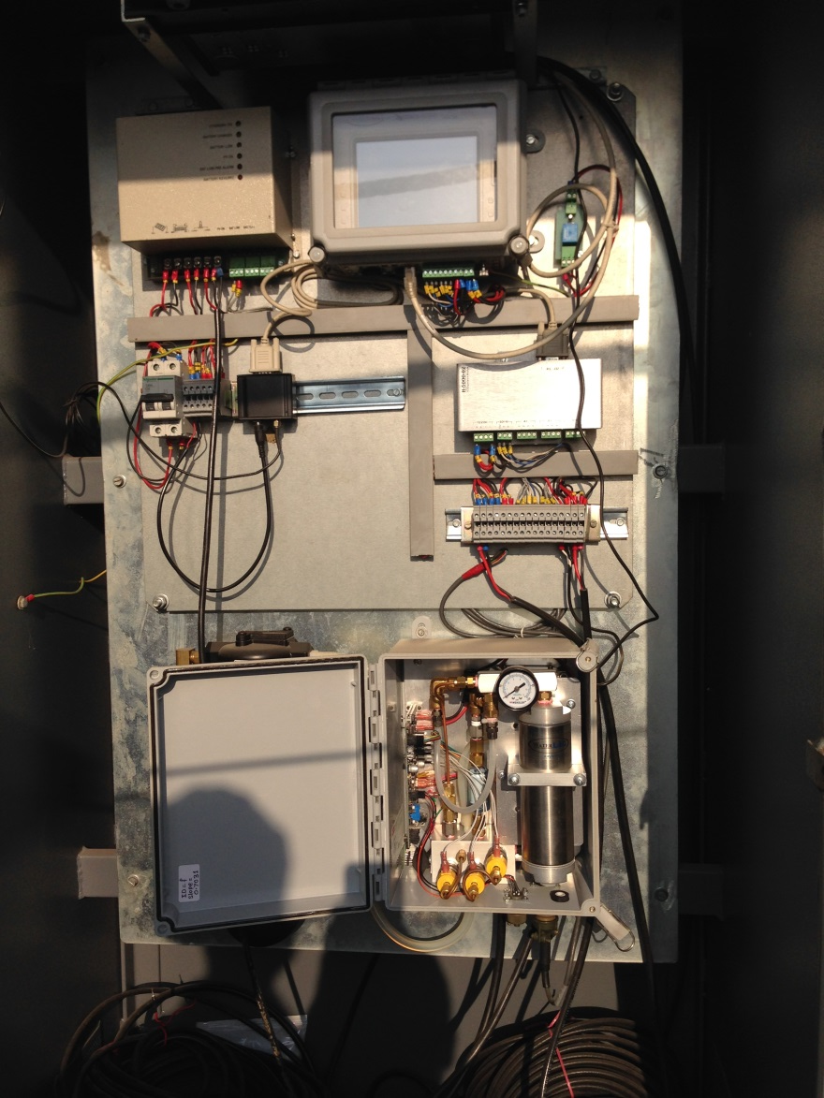
Bubbler Types and Location
Two Types
Non- continuous
Only turns on at a set time
This allows water to feed back up the orifice line so the line needs to be purged and stabilized
Continuous
Keeps the orifice line under pressure by producing approximately 1 bubble per second
Maharashtra Station
Ideal Location
Open Channels and Reservoirs
Stable river bed where channel does not migrate away from orifice
Not a lot of debris or sedimentation that can cover the orifice inlet
Great option if there is not a bridge or other structure with a direct vertical shot to the water surface.

Slide 12
Bubbler Advantages/Disadvantages
Advantages
It’s a Non-Submersible Pressure Transducer
Elimination of risk or damage of the most expensive part (pressure transducer and compressor)
Orifice line (least expensive component) only part in the water
Install is relatively inexpensive compared to the stilling well for the shaft encoder
Disadvantages
Expensive compared to shaft encoder, ultrasonic sensor and submersible pressure transducer
Not ideal for sites with migrating or shallow channel

Slide 13
Bubbler Advantages/Disadvantages
Advantages
Orifice tubing is inexpensive compared with data cables
Tubing can be run hundreds of feet if necessary, from instrument shelter to the river or stream. This is useful for rivers with widths that vary greatly from the dry to wet seasons.
Disadvantages
More mechanical parts to wear out or malfunction making maintenance more expensive and time consuming than other solutions.
System requires more power to operate compressor. (larger solar panels, batteries, etc.)

Slide 14
Submersible Pressure Transducer
Concept
The pressure exerted on the sensor by the head of water above the sensor is converted to depth.
Components
Submersible pressure transducer
Pipe or plastic conduit

Slide 15
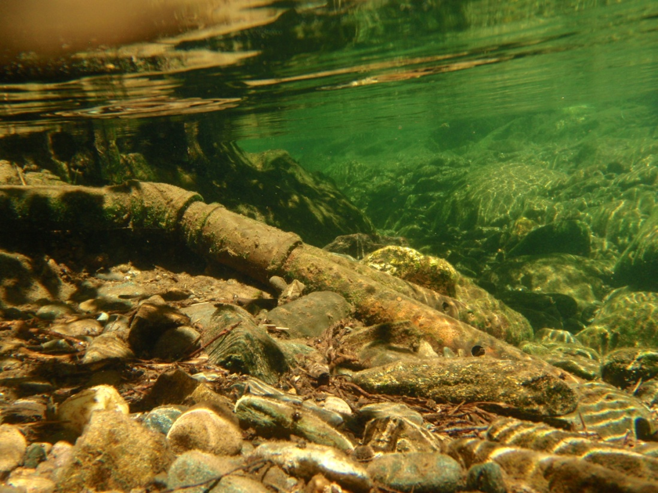
Submersible Pressure Transducer Installation and Setup
Installation
The transducer is installed in a pipe below the minimum water line
Ideal Setup
Protected area with little possibility of debris damage or theft
It is often used to measure water level in wells

Slide 16
Submersible Pressure Transducer Advantages/Disadvantages
Advantages
Relatively easy to install
Sensor only needs to be run down a pipe to some level that is lower than the expected minimum water level
One of the lowest cost sensors (ranging 50,000-80,000 INR)
Disadvantages
Contact solution is in contact with the water where it is vulnerable to debris during high water flows and water pollution
More susceptible to damage caused by vandalism or unintentional damage by animals or people.
Any required calibration must be performed at the factory

Slide 17
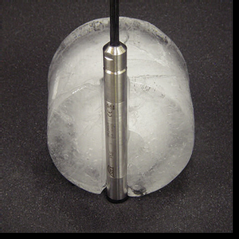
Submersible Pressure Transducer Advantages/Disadvantages
A common disadvantage of pressure transducers was their vulnerability to damage if frozen. Thus they weren’t a good option for high elevation streams that are subject to ice in the winter.
Some new products have now been developed with ceramic sensors that claim to overcome this problem.
If they prove to be reliable even after freezing they would be a good all-round choice for a water-level sensor in most applications (SW and GW)
Cost of cable is a consideration

Slide 18
Non-Contact Solutions:
Ultrasonic Sensor
Radar

Slide 19
Ultrasonic Sensor
Concept
The ultrasonic sensor measures the distance of target objects (water surface) by sending pulsed ultrasound waves at the object and then measuring the time for the sound echo to return. Knowing the speed of sound, the sensor can determine the distance to the object
Speed of sound is affected by temperature so compensation is needed
Components
Sensor
Mounting Platform
Pipe

Slide 20
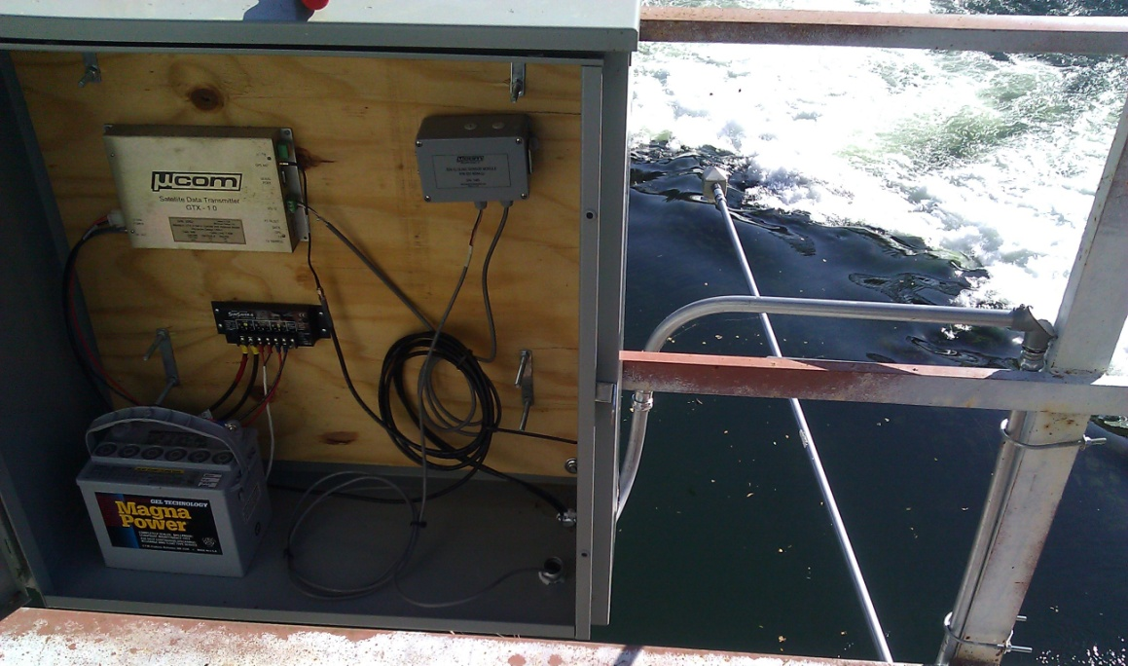
Ultrasonic Sensor Installation and Location
Installation
Requires some sort of bridge or platform to mount the sensor
Sensor must not have any object within the area of signal projection
Should be mounted where it can easily be accessed to repair if necessary
Ultrasonic Sensor
SDI-12 Converter
Data Logger
Signal Projection
Ultrasonic Sensor

Slide 21
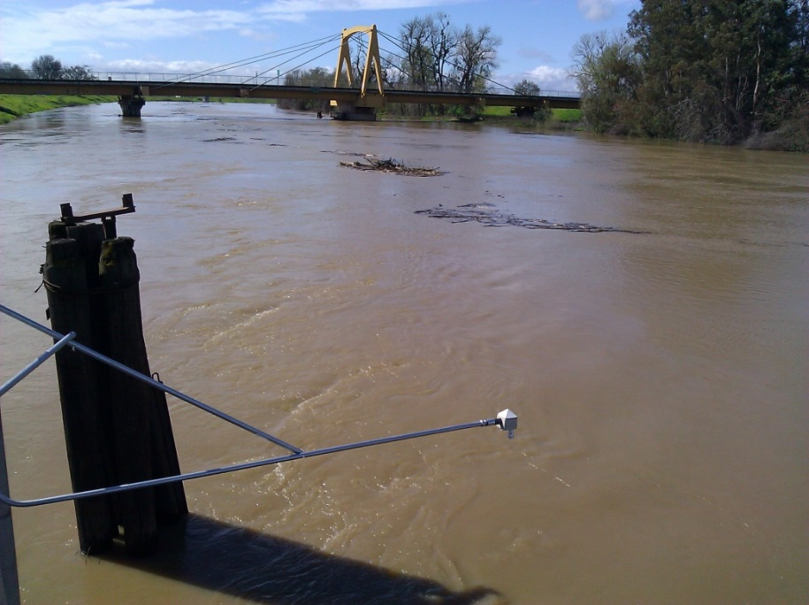
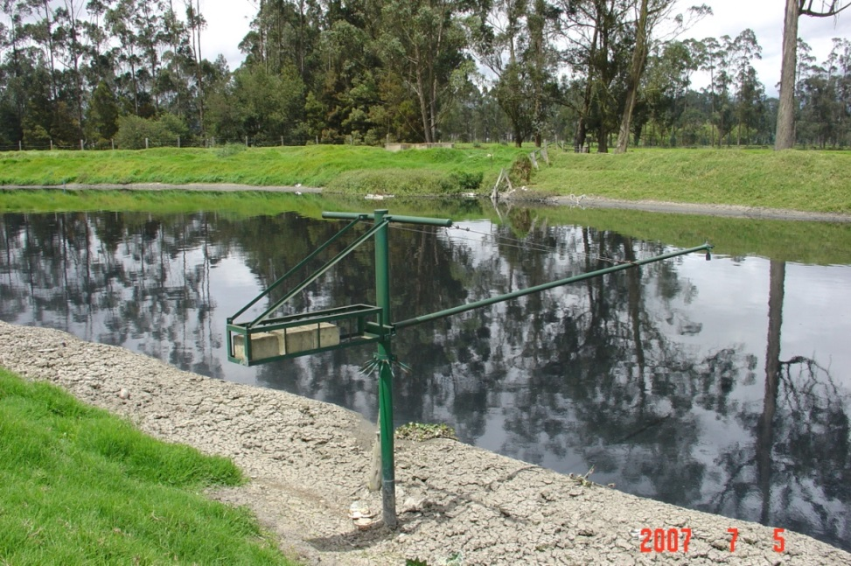
Ultrasonic Sensor Installation and Location
Ideal Location
Need a Bridge or Platform directly over water
Not practical in reservoirs or rivers with shallow slopes
More ideally suited for canals
Measurement distance up to 10m

Slide 22
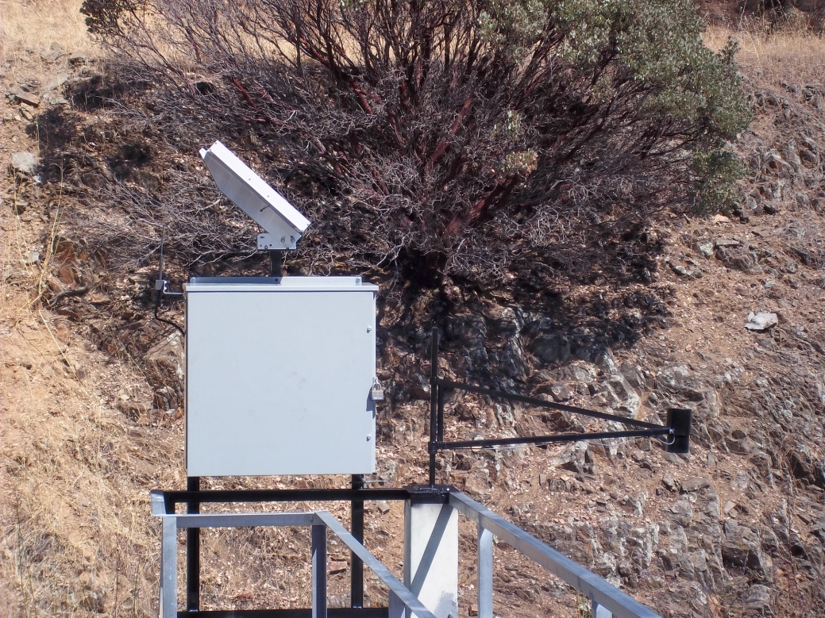
Ultrasonic Sensor Advantages/Disadvantages
Advantages
The advantage to the ultrasonic sensor is the price (around 75,000 INR)
Non-contact method of measurement. The measurement is generally unaffected by the transparency, reflectivity, opacity or color of the target
Disadvantages
Need structure to mount the sensor (bridge railing or boom)
Measurement is not as accurate as other measurement techniques, usually being within .25 to .4 % of the measured distance

Slide 23
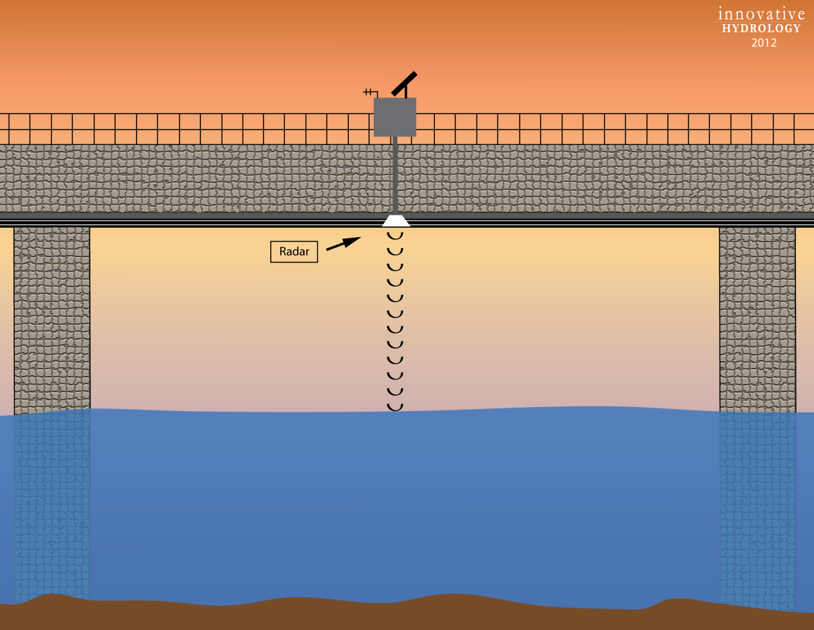
Radar
Concept
The radar works by releasing electromagnetic energy, which is reflected by objects with high dielectric properties (ex: metal and water)
The distance reflected by the microwave energy is determined by the measurement of the time of flight divided by the speed of light.
Various frequencies from 1 Ghz to 30 Ghz are typically used, with the higher the frequency, the more accurate and more costly the device
Components
Radar
Mounting Platform
Pipe

Slide 24
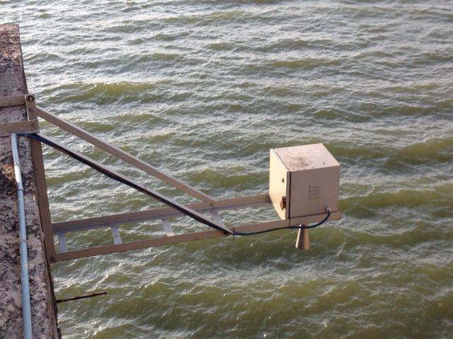
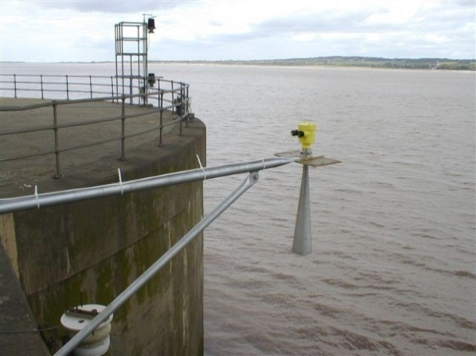
Radar Installation and Location
Installation
Requires some sort of bridge or platform to mount the sensor
Sensor must not have any object within the area of signal projection
Should be mounted where it can easily be accessed to repair if necessary
Ideal Location
Better than ultrasonic sensor for use in moist, vaporous, and dusty environments as well as in applications in which temperatures vary
Requires some structure (bridge railing or boom) to be mounted on

Slide 25
Radar Advantages/Disadvantages
Advantages
Non-Contact Solution
Radar will penetrate temperature and vapour layers that may cause problems for ultrasonic
Compared to the ultrasonic, radar provides a solution with a greater range of detection between the sensor and the water body (> 30 m)
The radar is more accurate than the ultrasonic sensor
Disadvantages
Need a bridge or platform to mount (same as ultrasonic sensor)
More expensive than ultrasonic sensor

Slide 26
Discharge
Acoustic Doppler Systems
Fixed mounts
Profilers
Other applications

Slide 27
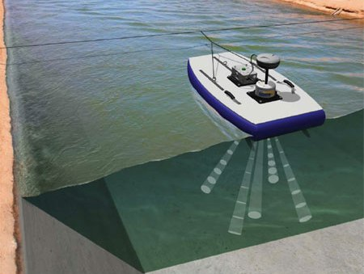
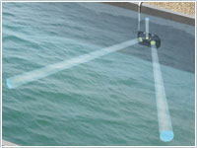
Acoustic Doppler Systems
Concept
Acoustic Doppler systems rely on SONAR which uses sound waves to determine the distance to targets
The Doppler Effect is used to resolve the velocity of flowing water by bouncing acoustic signals of a known frequency off backscatterers or targets in the water column and measuring the change in frequency of the return signal.
Targets are generally sediment or organic materials in the water column that are moving at the same velocity and direction as the water.
Types
Fixed
Current Profilers

Slide 28
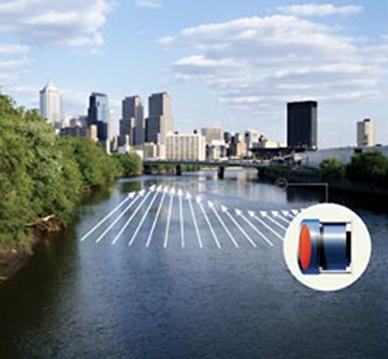
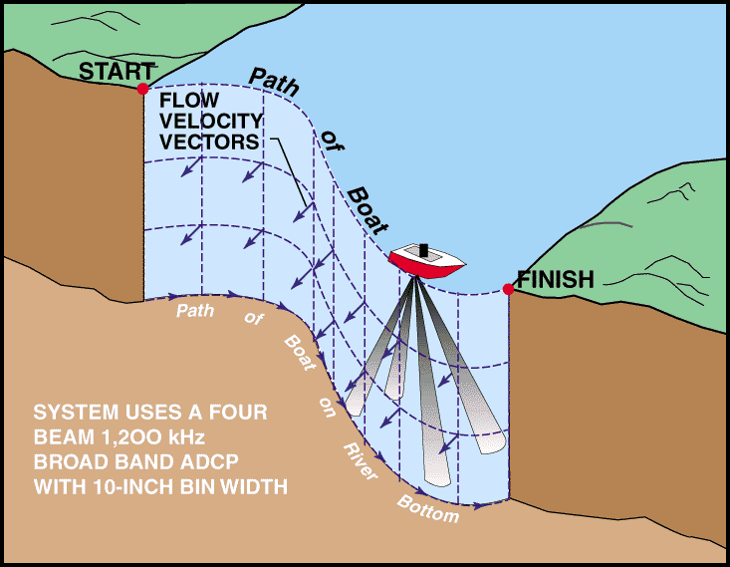
Acoustic Doppler Current Profilers (ADCP)
Acoustic Doppler Velocity Meters (ADVM)

Slide 29
ADVM - General Information
Well-suited for discharge measurements in canals with fixed channel geometry
Effective for monitoring discharge in tidally affected rivers or other unsteady flow reaches
ADVM’s can be a good alternative for streams where constant silting causes inaccuracy when using the traditional stage-discharge method.
Useful for acquiring detailed velocity data for model calibration.

Slide 30
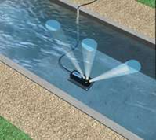
Upward Looking ADVM
ADVM is mounted to the bottom of the channel.
Channel shape is input into data logger for calculation of discharge.
Ideal Locations
Canals where the water is generally free from sediment and debris
Pipes or culverts flowing full or partially full

Slide 31
Side Looking ADVM
ADVM is mounted on or near one of the banks of a channel.
Velocity is calculated along beam paths and converted to average channel velocity using an “Index-Velocity” rating.
The cross-sectional geometry is surveyed and used to calculate discharge.
Ideal Location
Typically deployed in an natural channel
Reduces the chance for sediment covering the sensor
Sensor mounted out of the way of highest velocities and potentially damaging debris

Slide 32
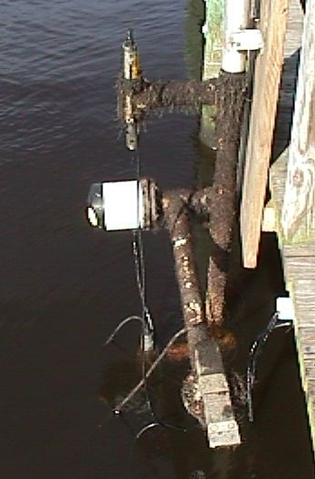
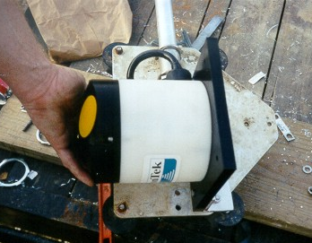
SonTek Argonaut SL
Notes:
Here are photos of the most common horizontal profiler – the SonTek Argonaut SL. The photo on the right shows a SonTek ADP SL at a gauge on the Columbia River in Oregon.

Slide 33
Nortek EZ-Q
Notes:
This is a Nortek EZ-Q mounted to a bridge pier in Indiana. It was mounted to the pier ‘facing’ towards the left bank. Do you notice anything odd or wrong about the discharge measurement being made in the photo on the right?
The streamgager is standing in the area that includes the sampling volume for the horizontal profiler.

Slide 34
Sontek Uplooker ADP
Notes:
This is a photo of a SonTek ADP uplooker that was used for some work in Florida. The ADP was direct-cabled to shore.

Slide 35
Sontek Argonaut SW
Notes:
Here is one of the newer profilers, the SonTek Argonaut SW. This profiler was originally designed for use in shallow canals and can be used to directly measure the flow. It is being used in several offices in the USGS as an index-velocity meter.

Slide 36
ADCP (Current Profiler)
Used for making instantaneous discharge measurements in lieu of standard mechanical meters using cups or propellers
Usually attached to a motorized boat or towed flotation device

Slide 37
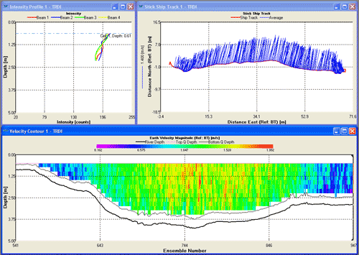
ADCP Discharge Measurement
Computes discharge on-the-fly
Provides complete velocity structure and channel geometry for model input

Slide 38
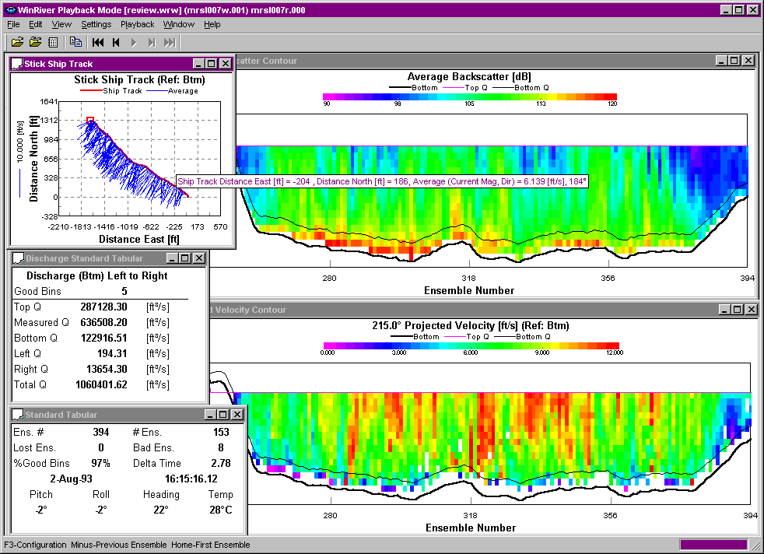
High Flow - Mississippi River
Notes:
Here is a high flow discharge measurement that was made at St. Louis during the 1993 Mississippi River Flood. This transect took less than 10 minutes to make and the measured discharge was > 1 million cubic feet per second. Even 4 passes (as required by OSW policy) would have only taken 30-40 minutes, not counting boat launch and retrieval. In comparison, Price AA measurements made near the gage from the Poplar Street bridge required 4-6 hours.
ADCP’s are great tools for making high flow discharge measurements and allow for significant improvement in efficiency. The Indiana District reported that they were able to make approximately 50 measurements in a 1-week period during a flood event in July 2003.

Slide 39
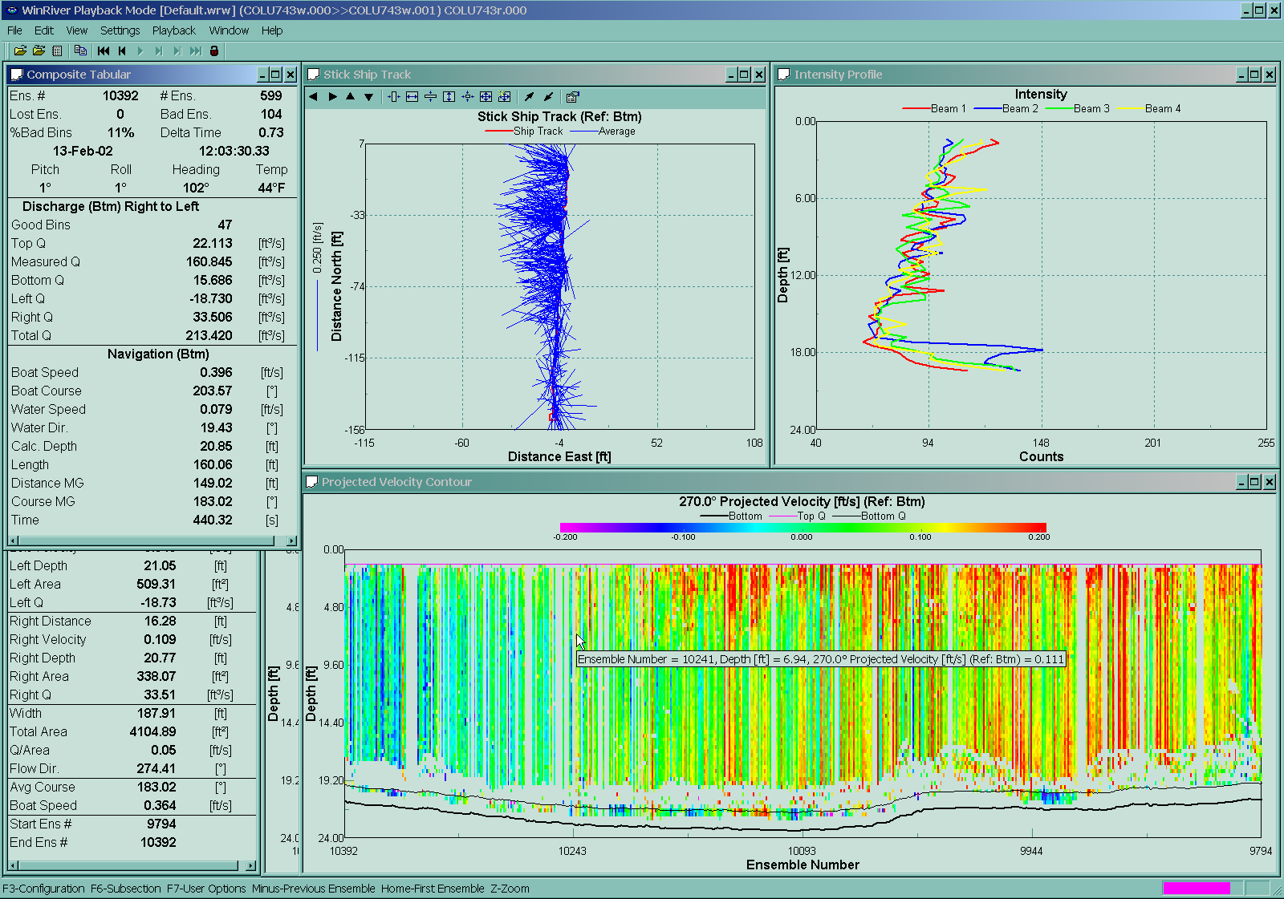
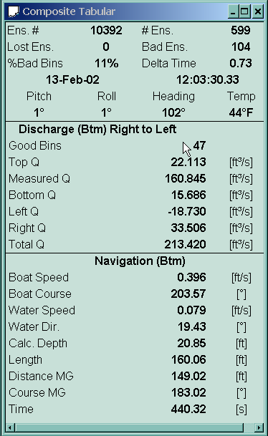
Low Flow Measurements
Mean Velocity = 0.05 ft/s
Notes:
This slide illustrates a discharge measurement of a very low flow – where the mean velocity was 0.05 ft/s ( xx cm/s ). This measurement was made in the Chicago River, where the cross sectional area is in excess of 4,000 square feet.

Slide 40
Index-Velocity Ratings
Notes:
ADCPs are also used to develop index velocity ratings such as the one shown here. At this site, prior to usage of the ADCP, no measurements were possible for velocities ranging from about 1.5 ft/s to 4.00 ft/s, due to the rapidly changing flow conditions and the time required to make a Price AA measurement. The measurements ranging from 2.4 to 3.2 ft/s (red dots) provided definition of the rating that was unavailable using conventional methods.

Slide 41
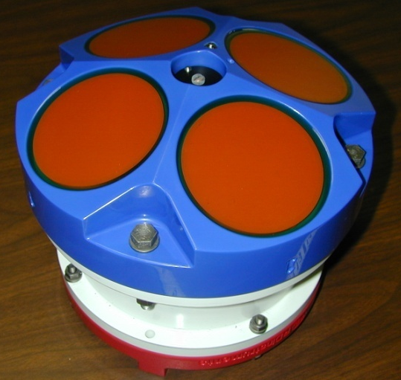
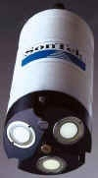
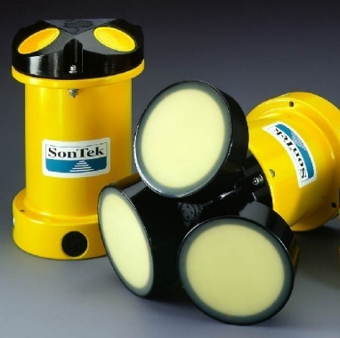
Some Commonly Used ADCPs
RDI StreamPro
RDI Rio Grande ADCP
SonTek Mini-ADP
SonTek ADP
Notes:
Here are some of the commonly used ADCP’s. One ADCP not shown is the Boogiedopp ADCP. The future of the Boogiedopp is somewhat ‘up in the air’ at present, although there are approximately 10 in use in the USGS.

Slide 42
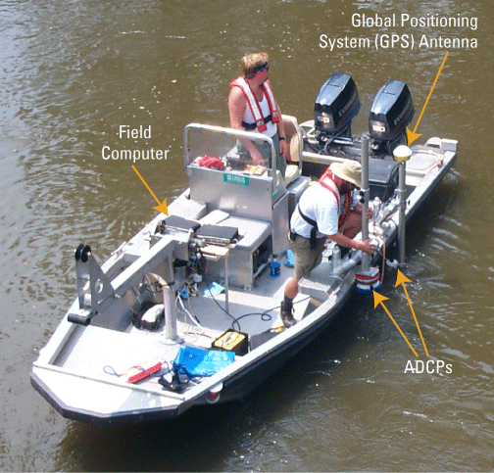
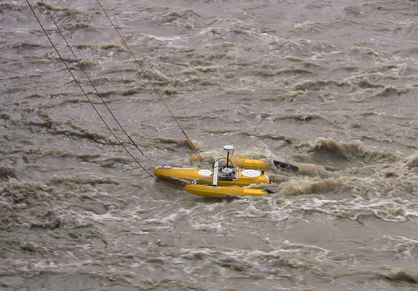
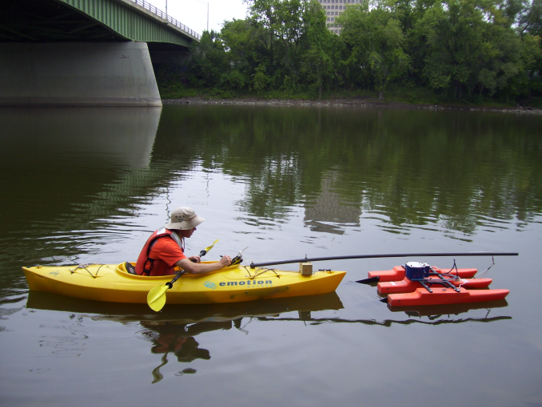
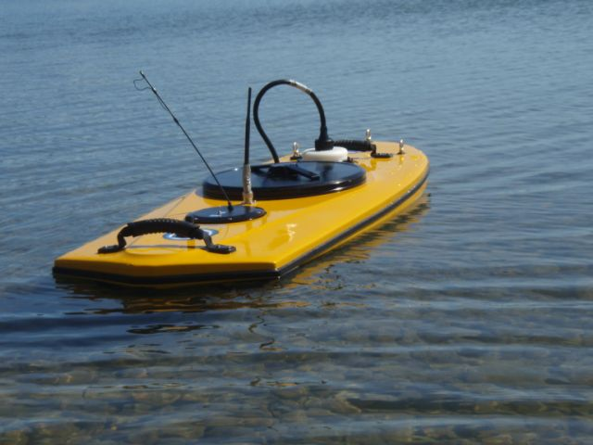
ADCP Deployment Methods
Motorboat
Tethered boat
Kayak (paddle boat)
Remote controlled boat

Slide 43
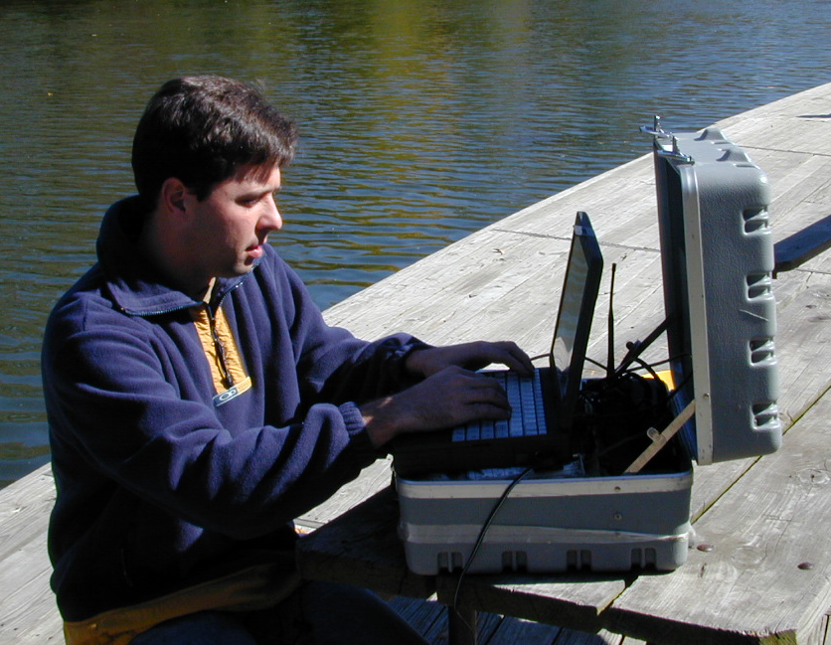
Streamflow Measurement – Tethered Boats
Notes:
This slide shows a tethered boat being used to make a discharge measurement. With tethered boats, ADCP data is radioed from the ADCP on the boat to the ADCP operator who is located somewhere on the shore (see photo on the left). Tethered boats measurements require 2 people, one to operate, configure, and collect data from the ADCP, and the other to operate the boat by means of a tether. This person can set up anywhere as long as he/she is within range of the radio modems. The other person tows the tethered boat back and forth across the measurement section (photo on the right).
What potential problems do you observe in the measurement being made on the right?

Slide 44
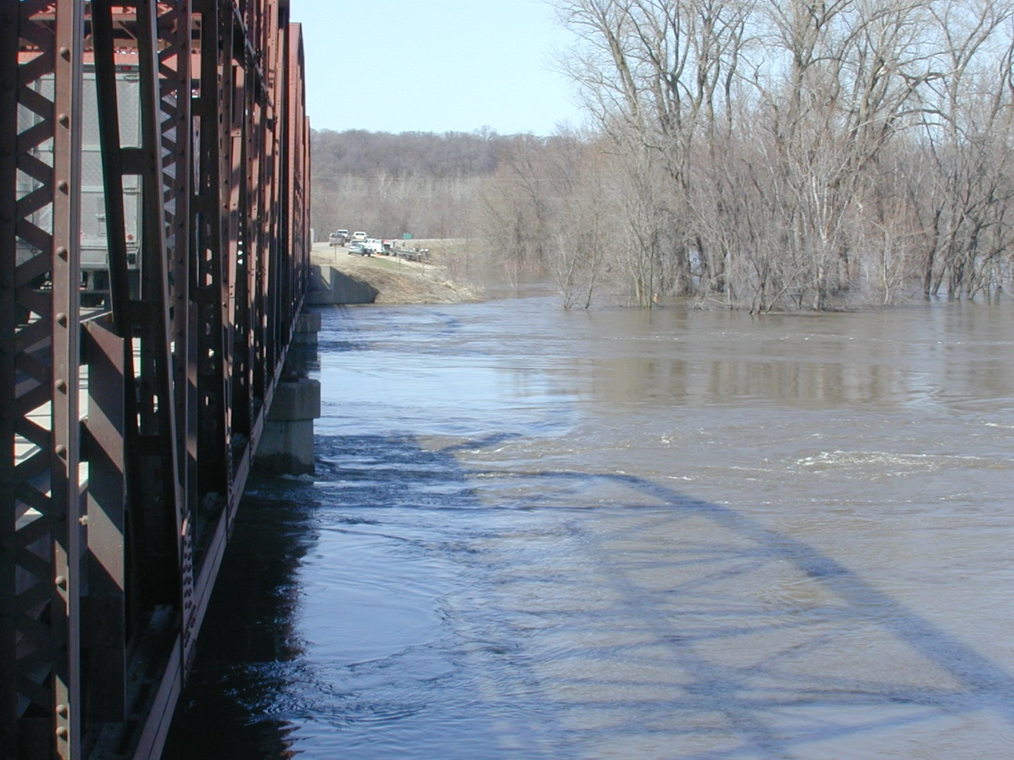
Site Problems
Complex currents, turbulence, and reverse flows around bridges can result in a poor measurement section
Bridges with truss structures make it difficult to tow a boat across the channel.
Notes:
Lots of turbulence downstream of piers. The left edge actually has reverse flow. Truss bridge makes it very difficult to tow the boat across the channel.

Slide 45
Tethered Boat Measurements
Advantages:
Less time on bridges compared to conventional bridge measurements, reducing exposure to traffic hazards
Fast and easy deployment
Can often be used where manned boats cannot be launched
Can move more slowly across the river with more control than a manned boat, depending on site conditions
Disadvantages:
Generally confined to the downstream side of bridge with limited ability to change measurement sections by changing rope length
Turbulence from bridge piers and abutments can degrade measurement quality
Notes:
Advantages:
Generally safer than using manned boats
Can be deployed easier and faster than manned boats
Can often be used where manned boats cannot be launched
Can be moved across the river more slowly and with more control than a manned boat; improving ADCP measurement quality at some sites.
Advantages of using tethered boats for ADCP measurements:
When compared to convention price AA bridge measurements, tethered boat ADCP measurements made from bridges require less time spent on bridges. This reduces the time people are exposed to traffic hazards.
Tethered boats can be quickly deployed from bridges without long setup time.
For sites where there is not a boat ramp for launching manned boats, tethered boats can be lowered from bridges, or used from cableways.
In many situations, especially in smaller streams, it can be easier to make a more controlled measurement when using a tethered boat compared to a large manned boat.

Slide 46
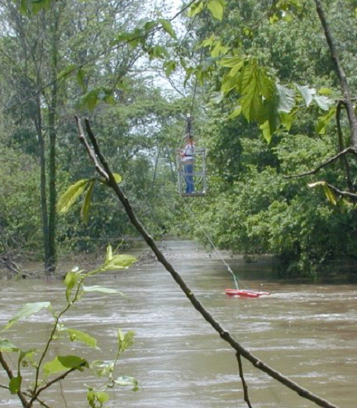
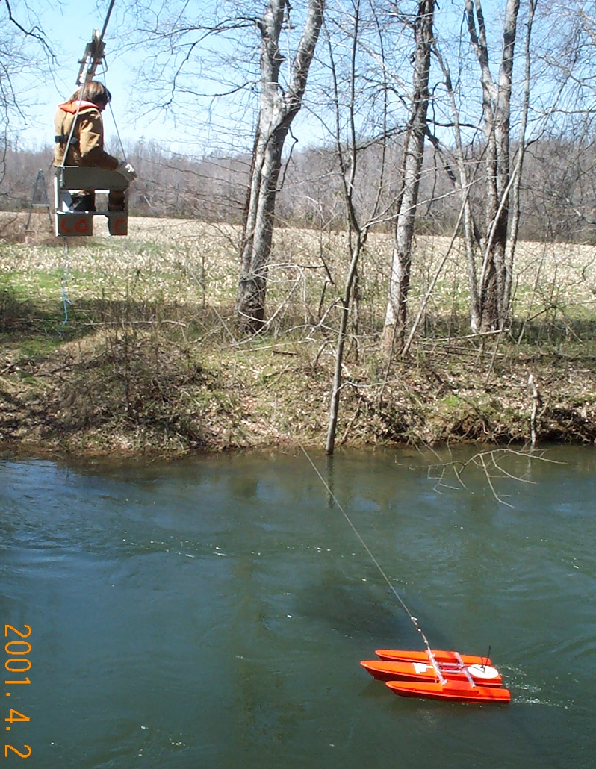
Cableway Measurements

Slide 47
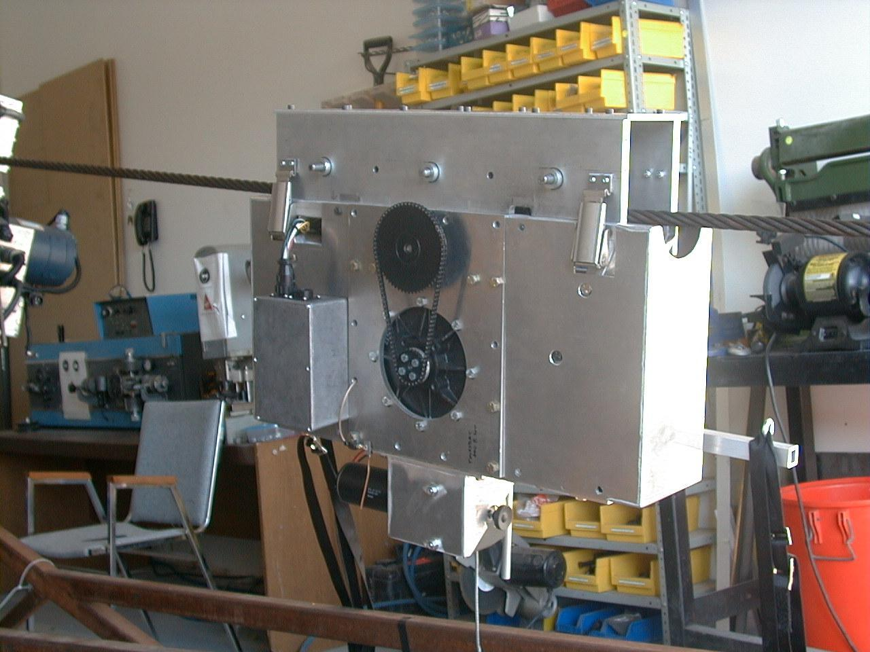
Cableway Measurements
Notes:
Canadian remote control cable way.

Slide 48
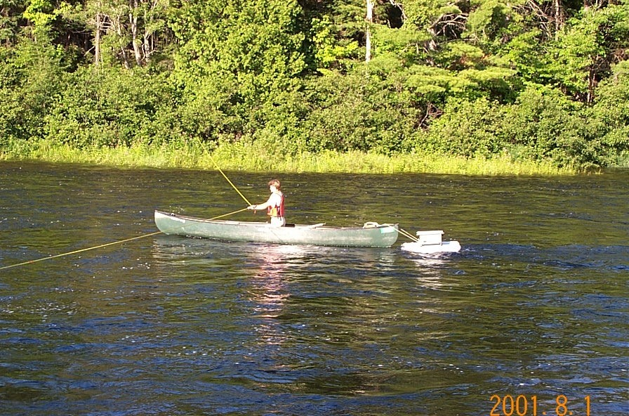
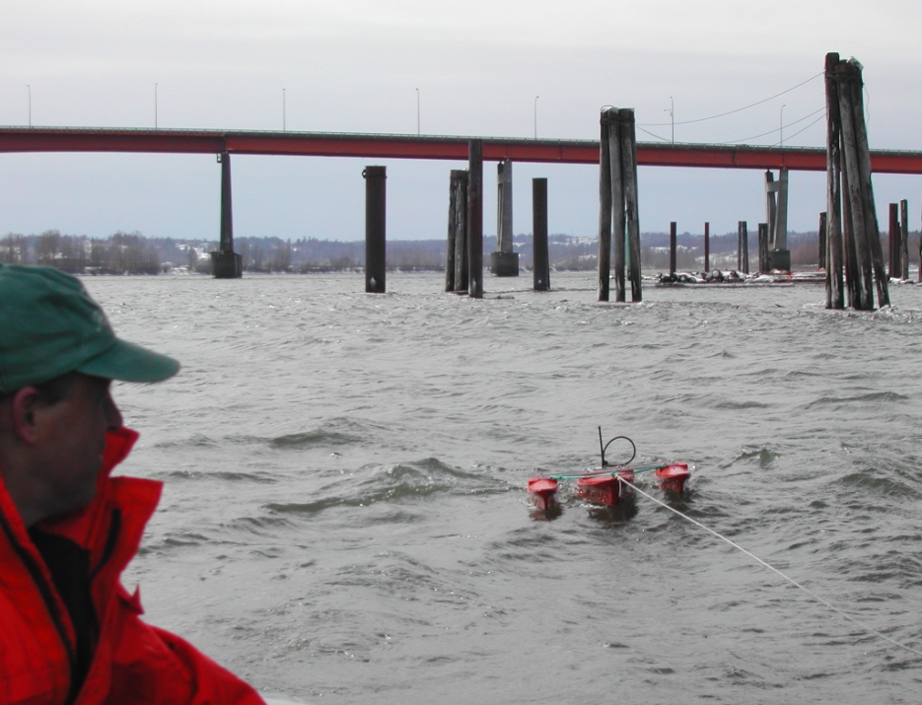
Tethered from a Manned Boat
Notes:
Gets ADCP away from biases and other problems caused by the manned boat (metal/compass problems, flow disturbance/boat wake problems, dampens effects of “jerky” boat pilot, less pitch and roll than on manned boat when in still water)
Potential problems…
On large rivers where there is a lot of “chop” a large stable manned boat may have less pitch/roll than a small tethered boat.
Be aware of any possible flow disturbances caused by the manned boat near the tethered boat.
Depending on the method of deployment, it may harder to control boat that are tethered to manned boats.

Slide 49
Streamflow Measurement – Remote Control Boats
Notes:
In addition to using manned and tethered boats for ADCP measurements, the USGS has invested into the development of remote-controlled (RC) boats. This remote control boat can be used where use of a manned boat is difficult or unsafe, such as insufficient clearance under bridges. It could be that in the future, as we perfect the development of RC boats and their control systems, many of our measurements will be made with RC boats. This particular boat was built under contract with OceanSciences Group. The video clip in the upper right shows an earlier prototype of this RC boat.

Slide 50
Other Applications for Acoustics
Sediment monitoring
Bathymetric mapping

Slide 51
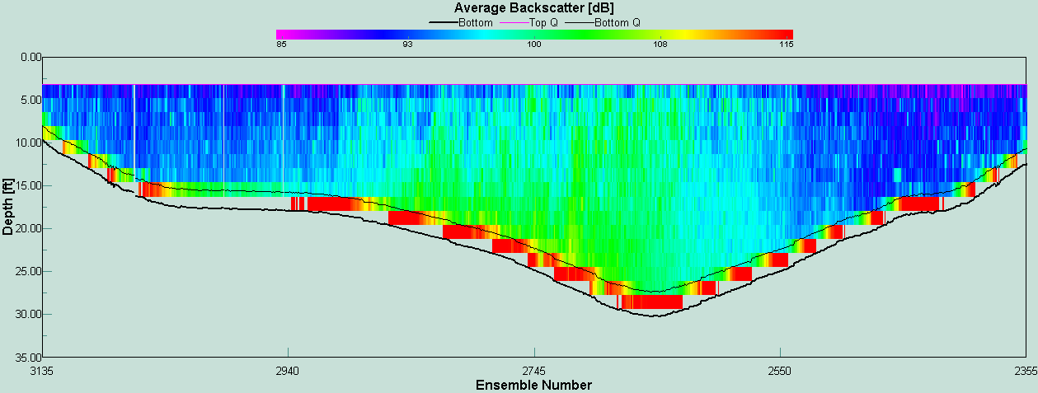
Using Acoustic Backscatter as a Surrogate of Sediment Concentration
Notes:
Another example of use of uplookers is from New York where an uplooker is being used to estimate suspended sediment loads on the Hudson River. Shown here is a backscatter contour plot from WinRiver. The question is, Can we use acoustic backscatter (ABS) as a surrogate for suspended sediment concentration? When one studies backscatter contour plots such as this one, it seems possible, at least qualitatively.

Slide 52
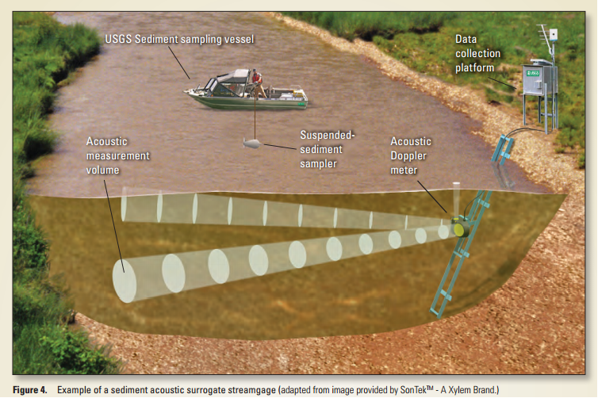
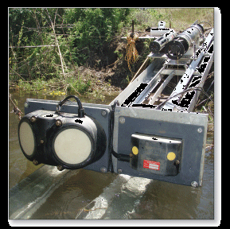
Sediment Monitoring
Successfully used to measure instantaneous suspended sediment concentration
Instrumentation at research project comparing various surrogate methods (acoustics, turbidity, laser)

Slide 53
Acoustic Backscatter and Velocity
Backscatter
Velocity
Notes:
Here are some preliminary results showing velocity and backscatter measurements made over a number of tidal cycles. You can see the increase in backscatter that corresponds to the increase in the velocities.

Slide 54
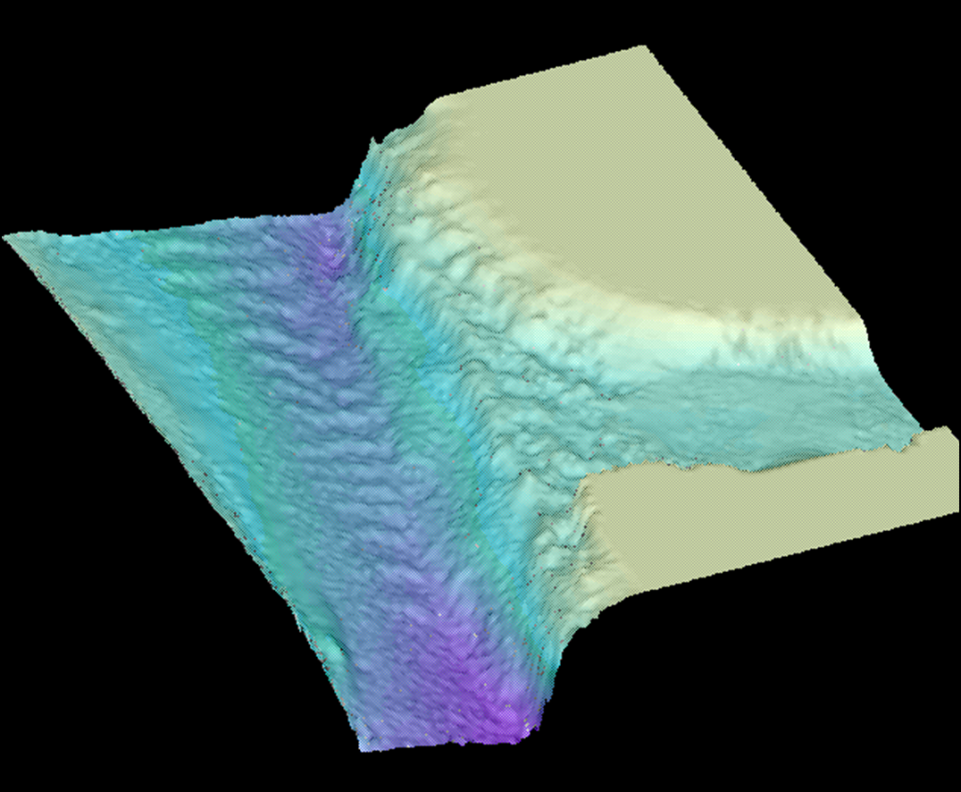
Bathymetric Mapping
Notes:
Another example of use of uplookers is from New York where an uplooker is being used to estimate suspended sediment loads on the Hudson River. Shown here is a backscatter contour plot from WinRiver. The question is, Can we use acoustic backscatter (ABS) as a surrogate for suspended sediment concentration? When one studies backscatter contour plots such as this one, it seems possible, at least qualitatively.

Slide 55
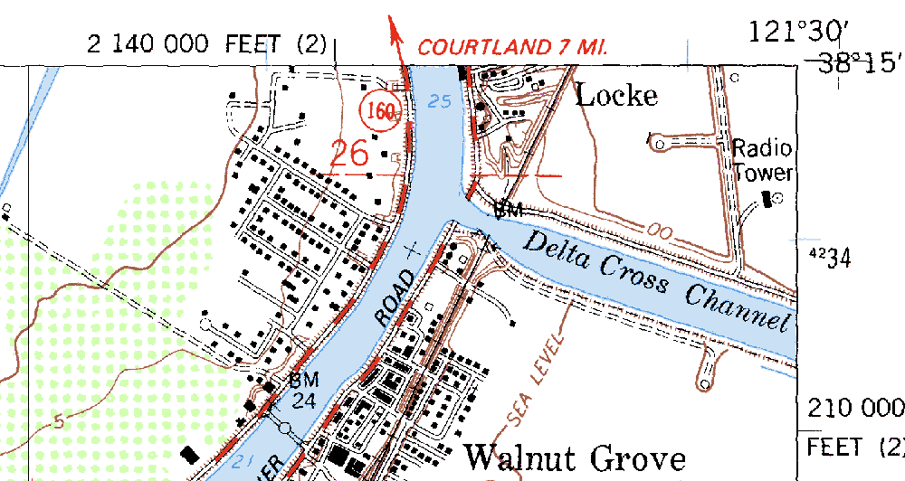
Bathymetric Survey for Model Grid Generation
Survey Grid
Notes:
The data in the subsequent slides were collected in the area designated by the red square in the center of this map. Randal and others are looking at the interaction of flow from the Sacramento River and the Delta Cross Channel.

Slide 56
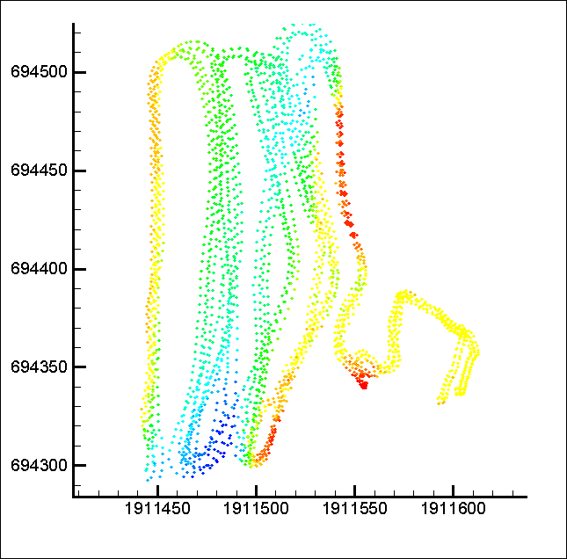
Use of Individual Beams for Bathymetry
Two tracks
Notes:
Randal’s macros allow all depths and locations for all four beams to be computed and used for make a map of the bathymetry. Here, for every ensemble, 4 beam depths were obtained. The beam depths are color coded based on the depth, with blues indicating deeper depths and yellows shallower depths.

Slide 57
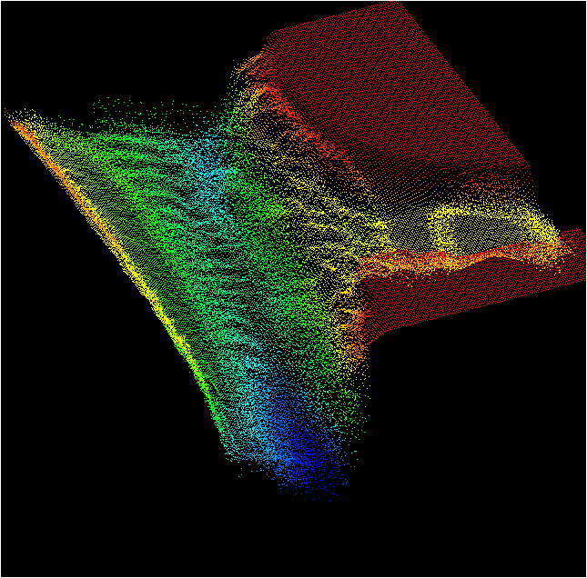
Bathymetric Map Generation
Interpolation of bed elevations to x-y-z grid
Surface
Shading of
x-y-x grid
Notes:
Using 60 transects in this area, and the beam depths obtained from these measurements, a 3-D surface of the bed can be created as shown here.
Do you notice any interesting features regarding the bed?
The bathymetry from the ADCP is good enough to resolve dunes in the Sacramento River (running roughly from the top left to the bottom center of the map.

Slide 58
Modeling 3-D velocity structure at a complex location
Notes:
Randal then extracted the velocity data for those same 60 transects (over 2 tidal cycles). He imported them into a program called TecPlot and developed an algorithm for interpolating the velocity data at each location on to a regularly spaced grid. This shows an animation of the velocity field over 2 tidal cycles. The colors of the vectors correspond to the elevation (or depth) associated with each vector. Notice the exchange that takes place between the Sacramento River and the Delta Cross Channel. Notice how flow actually reverses and goes upstream and into the Delta Cross Channel.

Slide 59
Acoustic Doppler Systems: Advantages/Disadvantages
Advantages
Measures discharge in a wide variety of unsteady flow situations and where no stage-discharge relation exists
Ideally suited for estuaries and canals
Instantaneous Discharge
Saves time over conventional measurements saving time and improving safety
Potential application in sediment monitoring and bathymetric surveys
Disadvantages
Complexity (requires significant and ongoing training)
Costs are high but coming down

Slide 60
Ground Water
Concept
Continuous ground water levels are most commonly measured with a submersible pressure transducer
The measured pressure is converted to water depth over the sensor and from that depth to water from the surface can be calculated

Slide 61
Ground Water Applications
External Data Logger
Suited towards adding additional equipment to data loggers such as rainfall, evaporation, or other hydromet measurements
Internal Data Logger
Standalone system for just ground water level recording
Internal batteries
No solar panels required
Additional features such as GPRS and water quality

Slide 62
Ground Water Continued
Other options
Vented cable compensates for barometric pressure changes
Non-vented cable requires post-processing to determine water level

Slide 63
Data Loggers
Concept
Data loggers interrogate sensors and store data at hydromet stations
Often coupled with telemetry devices for transmitting data from remote sites to central data management center
Data loggers can trigger and record measurements at any set time
This includes all digital and analog hydrological and meteorological sensors
Other measured parameters include solar panel input and battery voltage used by technical personnel

Slide 64
Common Features of Data Loggers
Screen to view/alter data and configure devices
Very low power consumption
Multiple communication ports for simultaneous data relay (GSM/GPRS, INSAT, VSAT)
Analog, Digital, RS-232, SDI-12 Data Inputs
Digital, RS-232 outputs
Frequency of collection/logging can be different for each sensor
Logging/Transmissions can be triggered based on a measured event

Slide 65
Common Features of Advanced Data Loggers
Ability to switch on/off power to sensors (power saving concept)
No data loss upon power loss
Automatic start up when power is restored
Program upload feature
Can calculate and store values based on sensor inputs

Slide 66
EXAMPLES OF DATALOGGERS
Datalogger with Touch screen
Datalogger with LCD display
Datalogger with no display
Datalogger with built-in satellite transmitter

Slide 67
EXAMPLES OF DATALOGGERS

Slide 68
Instrument Considerations

Slide 69
Accuracy and Precision
Sensor accuracy
Resolution
Range
Drift
Clock accuracy
Response time
QA testing (trust but verify)

Slide 70
Technical
Power requirements
Input/Output connections
Type
Number
Memory protection
Surge protection
Data storage capacity
Data handling (fill and stop or write over)
Software and firmware
Programming interface (display, PC, tablet)

Slide 71
Environmental
Operating range for temperature and humidity
Thermal and mechanical shock (transportation, storage, and deployment)
Vibration
Solar radiation
Wind
Sand and dust
Ice
Corrosion
Build quality (internal and external)
Regulatory compliance (frequency, signal strength, FCC approval)

Slide 72
Operational
Maintenance requirements
Complexity
Installation
Programming
Calibration
Expandability

Slide 73
Procurement
Specifications
Too few can result in unacceptable products
Too many can cost more and miss a good solution.
Warranty
Vendor support (technical and warranty)
Cost

Slide 74
Resources
USGS Hydrologic Instrumentation Facility (HIF) Instrument Evaluation Program http://water.usgs.gov/hif/programs/instrumenteval/
HIF Evaluation Guidance Report http://water.usgs.gov/hif/programs/instrumenteval/HIFEvaluationGuidance.pdf
USGS Water Supply Paper 2175 http://pubs.usgs.gov/wsp/wsp2175/html/WSP2175_vol1_pdf.html
USGS Office of Surface Water memo 96.05 http://water.usgs.gov/admin/memo/SW/sw96.05.html
USGS Techniques of Water-Resources Investigations Reports (TWRI) http://pubs.usgs.gov/twri/
Book 3 – Field Measurement of Fluvial Sediment
Book 8 – Groundwater Instrumentation
Book 9 – National Field Manual for the Collection of Water-Quality Data

Slide 75
Cost Table (Approximate)
Item | Cost (USD) | Cost (INR)
Shaft Encoder | 1,000 | 60,000
Bubbler | 3,000 | 180,000
Pressure Transducer | 1,000 | 60,000
ADCP | 20,000 | 1,200,000
ADVM | 5,000 | 300,000
Ultrasonic Sensor | 1,500 | 90,000
Radar Sensor | 3,000 | 180,000
Data Logger | 2,000 | 120,000

Slide 76
Questions/Comments?

